Slide 1
Get started selling on the Open Food Network Producers at US Farmers Markets

Slide 2
What we will cover today
Get you registered on Open Food Network
Get your shop set up
Enter your first products
Learn how to connect with other shops to create a food hub, shared delivery etc
Set up an order cycle
Access reports to manage your orders
Helpful links for getting assistance
More Info
What the Open Food Network does

Slide 3
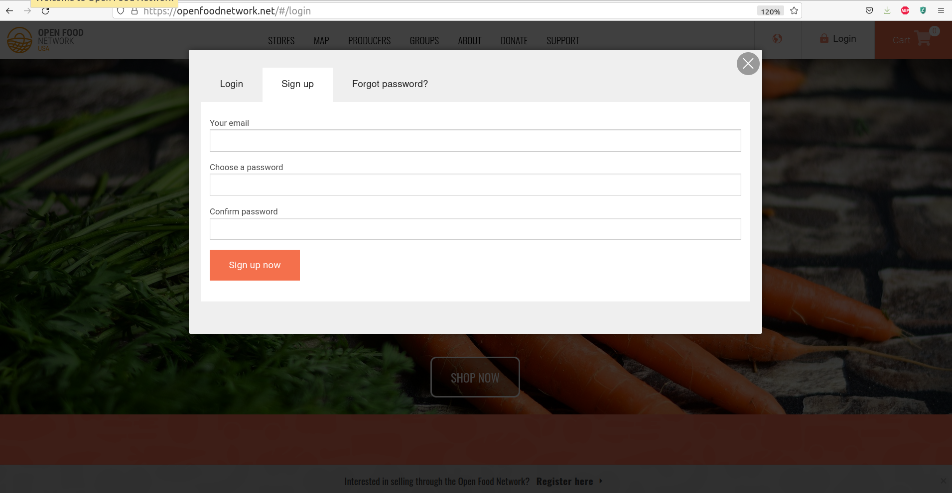
Get registered
https://openfoodnetwork.net/#/login
You will receive an email to confirm your address.
Click the link in the email and then login

Slide 4
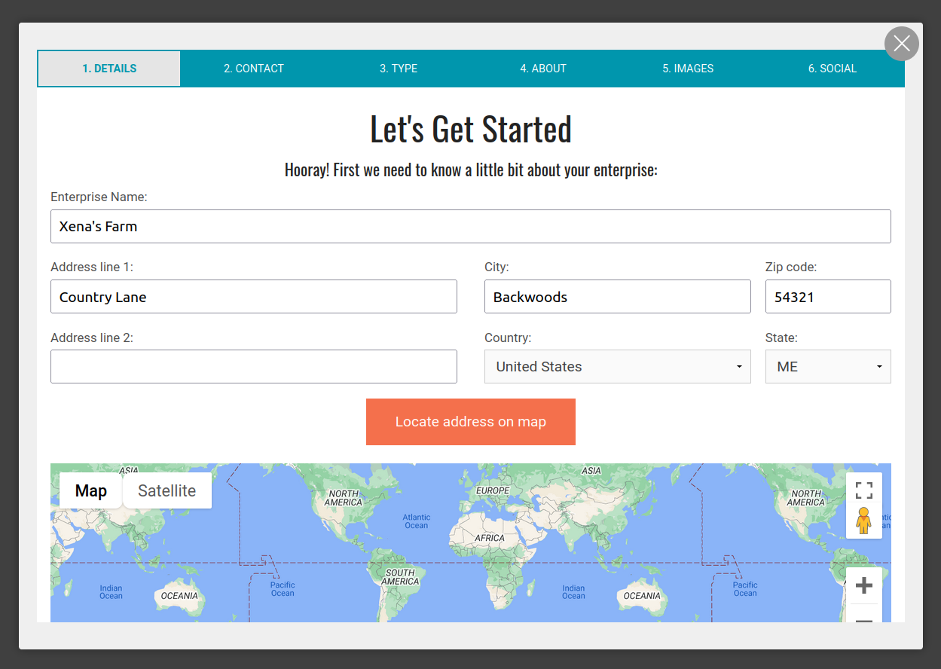
Get registered
https://openfoodnetwork.net/register/auth?after_login=%2Fregister#/signup

Slide 5
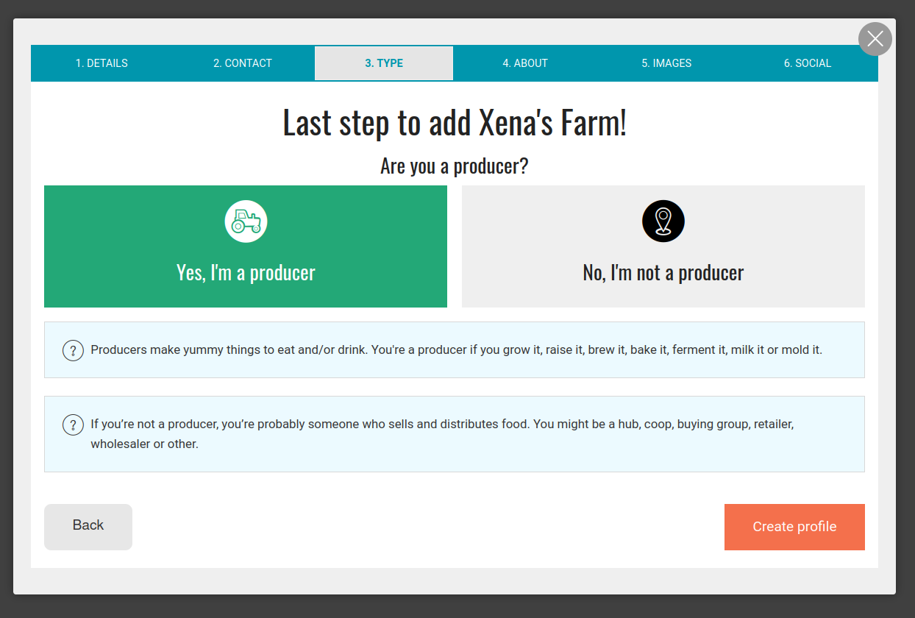
2. Choose a package
Select “I’ll share my own produce”
‘Create Profile’ to continue

Slide 6
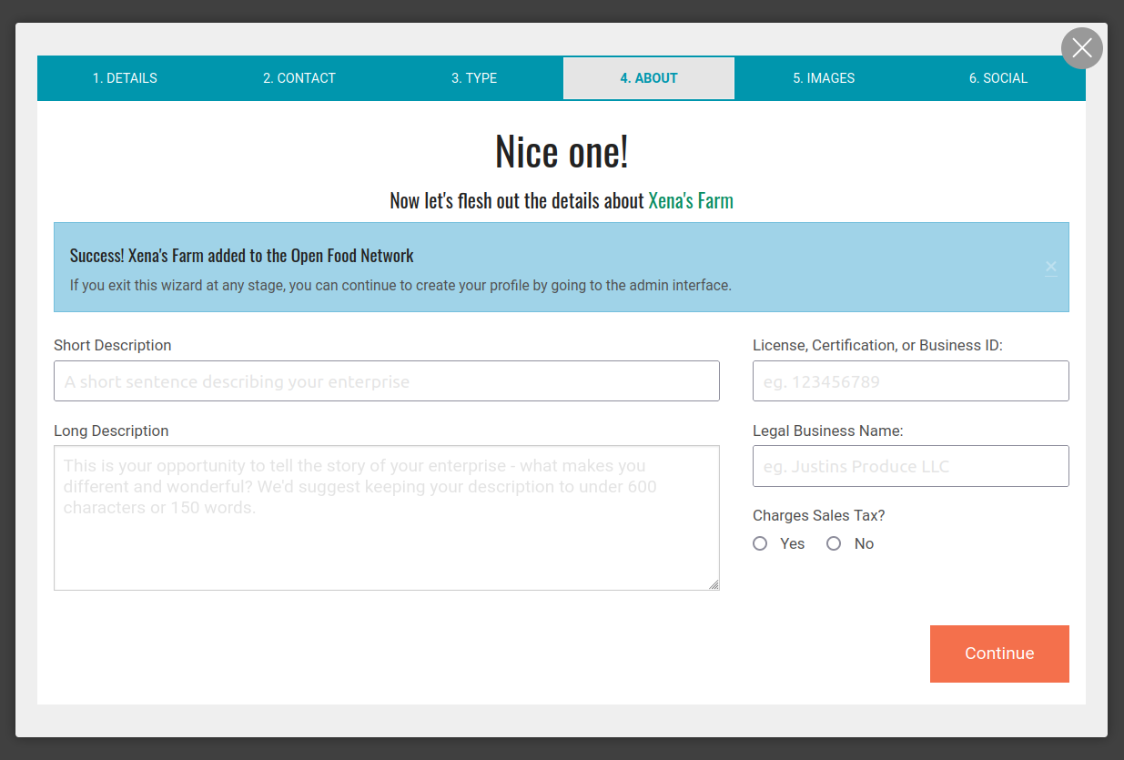
3. Add to your profile
https://openfoodnetwork.net/admin
You have to make your Sales Tax choice now.
You can add further information to your profile - you can also easily fill this out / edit it later.
You can now access the administration interface to manage your enterprise via https://openfoodnetwork.net/admin

Slide 7
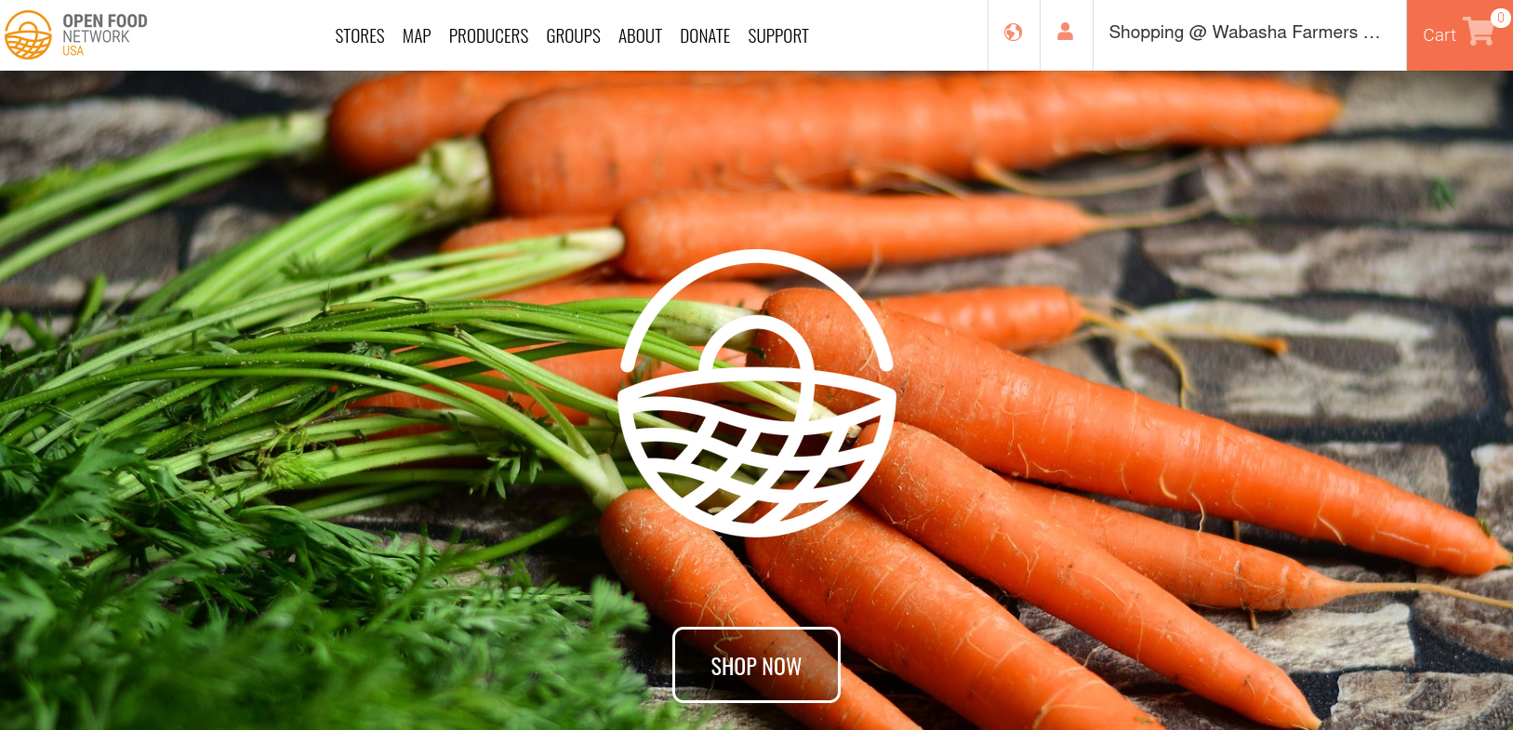
3. Accessing your shop’s admin
Go straight there: https://openfoodnetwork.net/admin or click the person

Slide 8
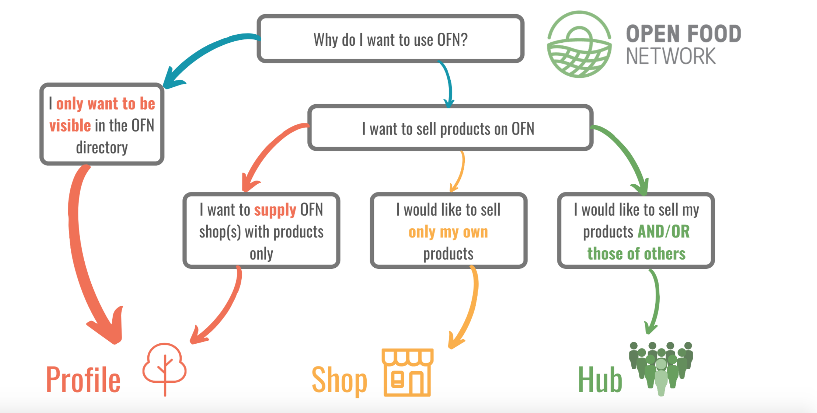
You have options to sell your products ONLY through a Hub, or also in your own individual shop
You could also become a ‘hub’ and also sell products from other farmers . . but let’s leave that for now . .

Slide 9
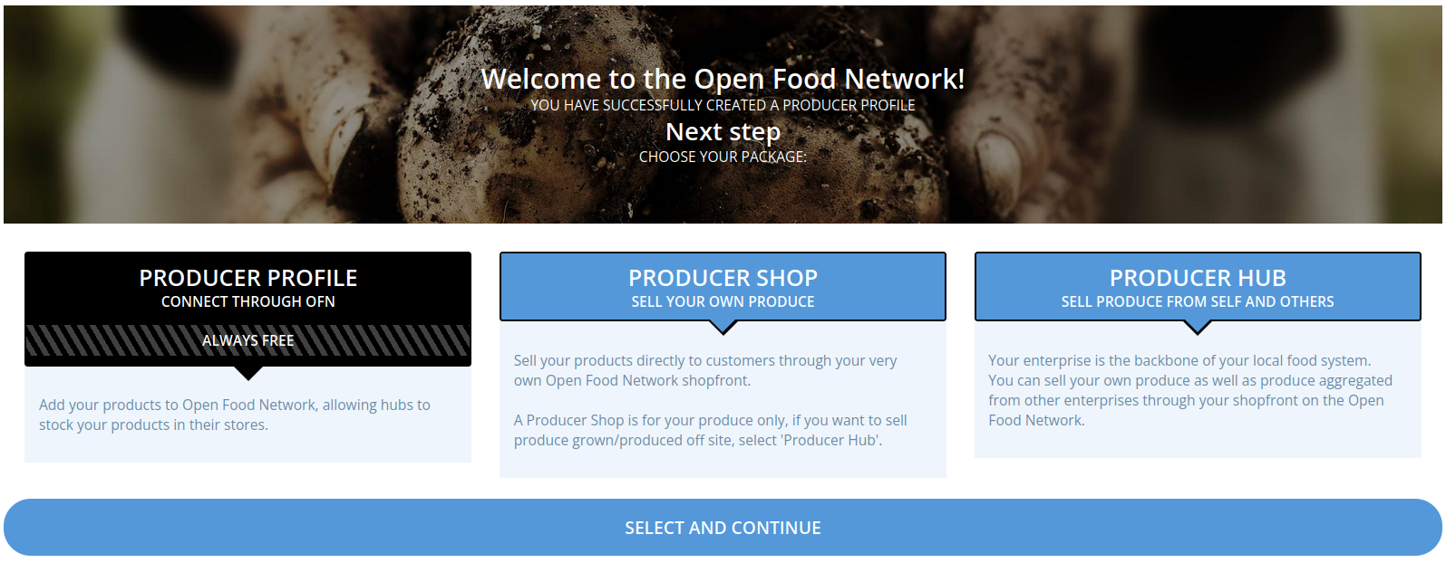
3. To sell through a Hub, you only need a Producer Profile

Slide 10
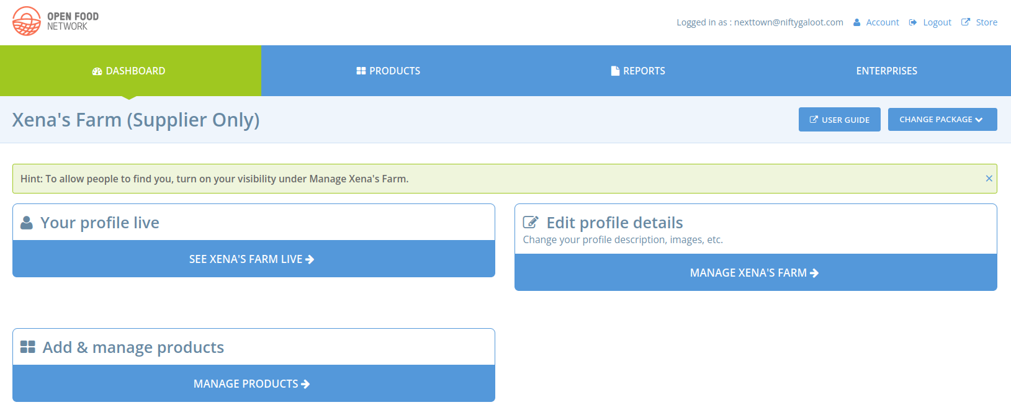
3. Here’s your backend administration!

Slide 11
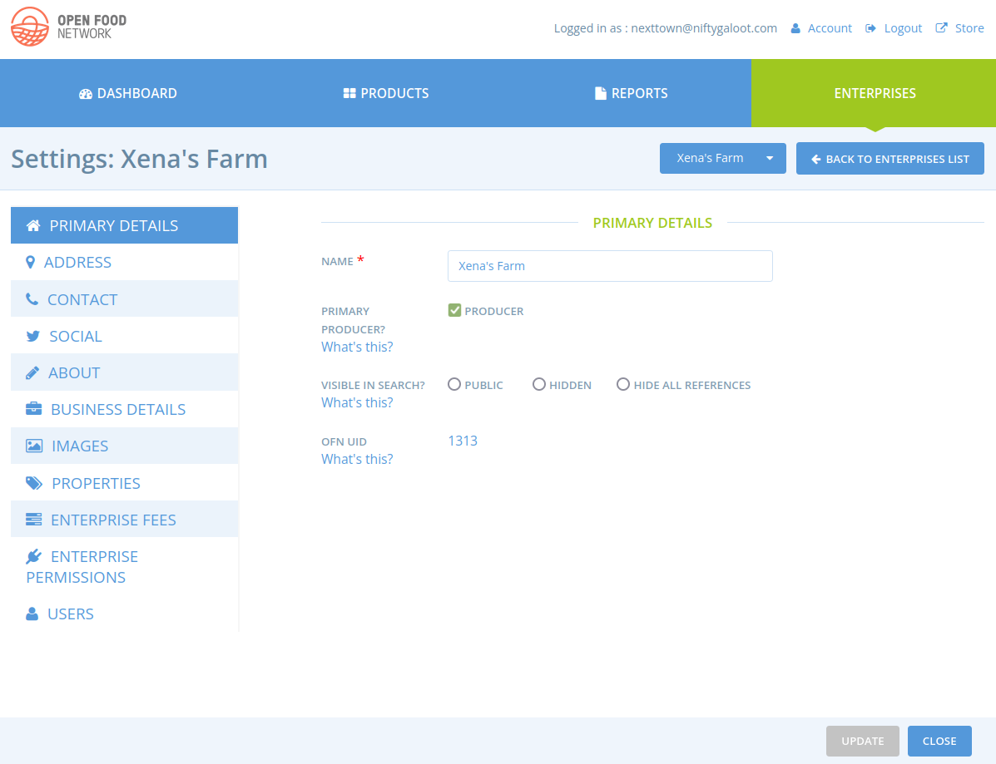
3. This is your Enterprise Settings page - you can edit your profile from here
E.g. address https://openfoodnetwork.net/admin/enterprises/xena-s-farm/edit#!/primary_details
Update social links, contacts, about us and images
When you are ready you can set to ‘Visible’ and your profile will be visible in the map and directories
NB. If you have selected Profile Only (slide 9) you will not have all of the options a shop or hub has. Some of them are only required for actually setting up your own shop

Slide 12
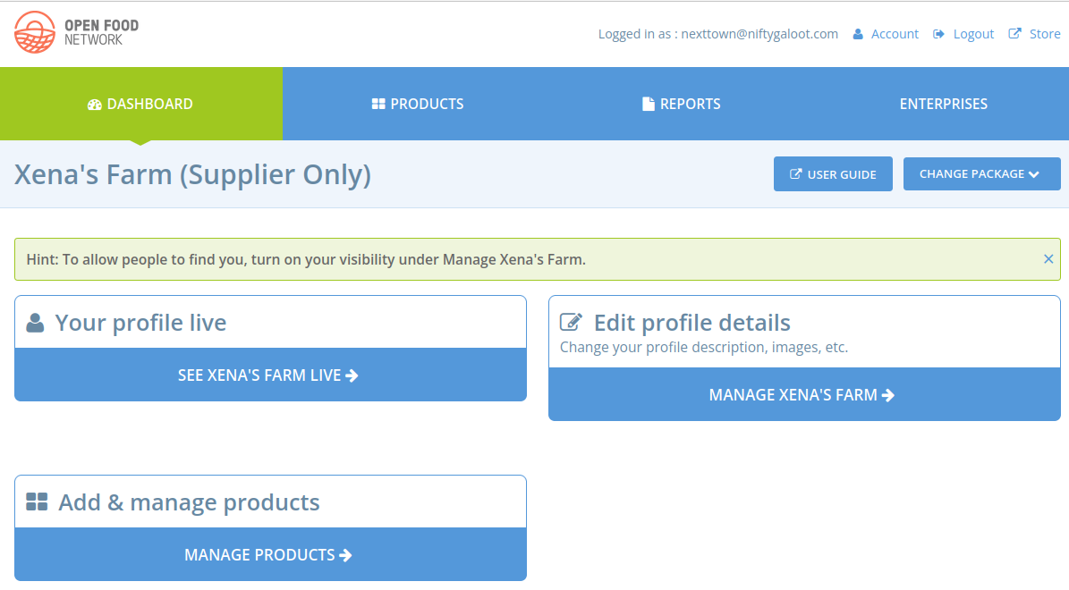
4. Create Products

Slide 13
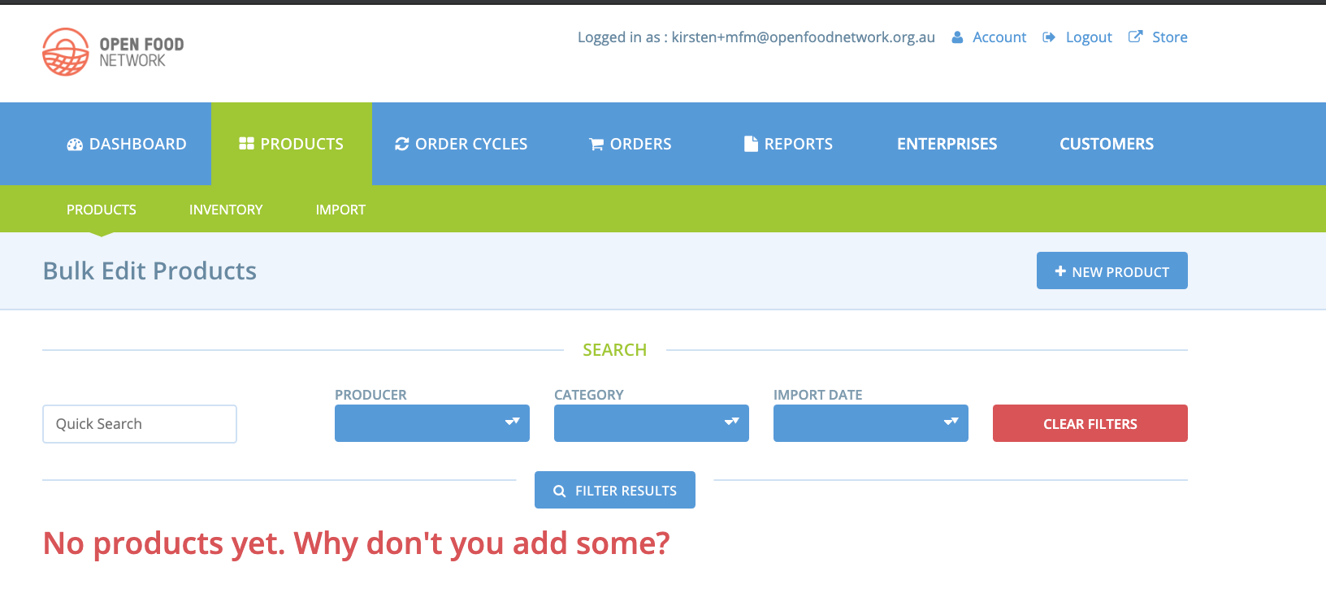
4. Enter your products (if you’re a producer)
https://openfoodnetwork.net/admin/products
For each product, enter at minimum the following information:
Product Name (eg. 5lb Bag of Potatoes)
Units (eg. lb)
Value (eg. 2)
Price (eg. $6.50)
You can also specify stock levels and add a description and images for each product.
More information in the OFN User Guide about adding products: https://guide.openfoodnetwork.org/basic-features/products-1/products

Slide 14
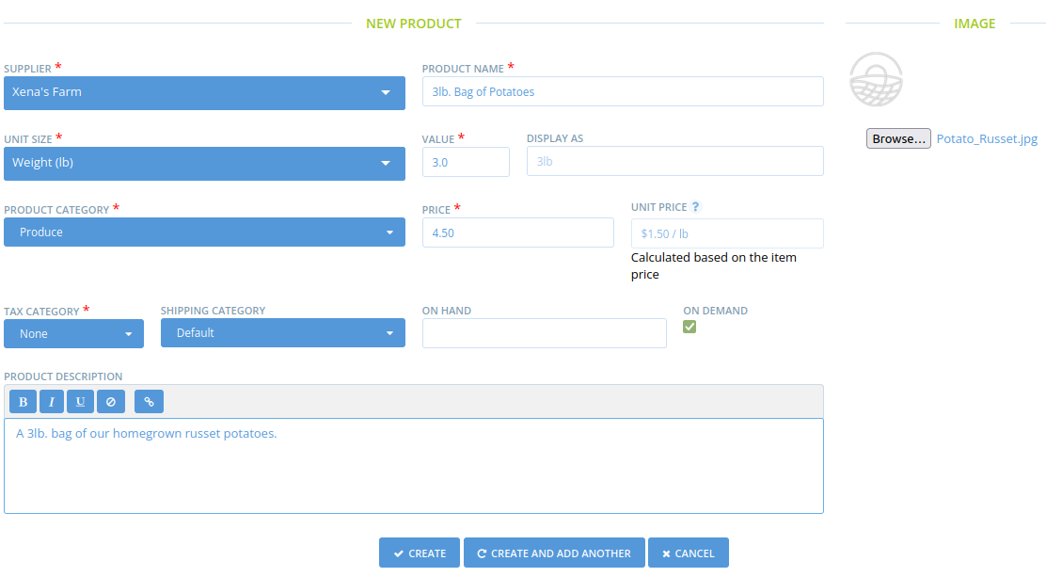
4. Enter your products (if you’re a producer)
https://openfoodnetwork.net/admin/products

Slide 15
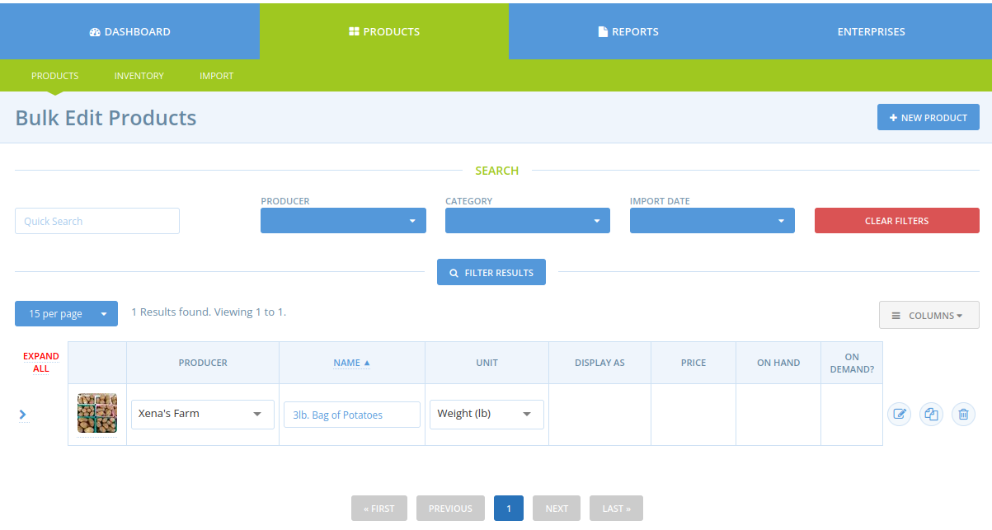
4. Enter your products (if you’re a producer)
https://openfoodnetwork.net/admin/products
‘Expand All’ to add variants, of the same product e.g. different sizes or varieties
More information in the OFN User Guide about adding products: https://guide.openfoodnetwork.org/basic-features/products-1/products

Slide 16
5. Connect to Farmers Market Hub
https://openfoodnetwork.net/admin/enterprise_relationships
Your Enterprise (Producer or Maker)
Farmers Market Hub

Slide 17
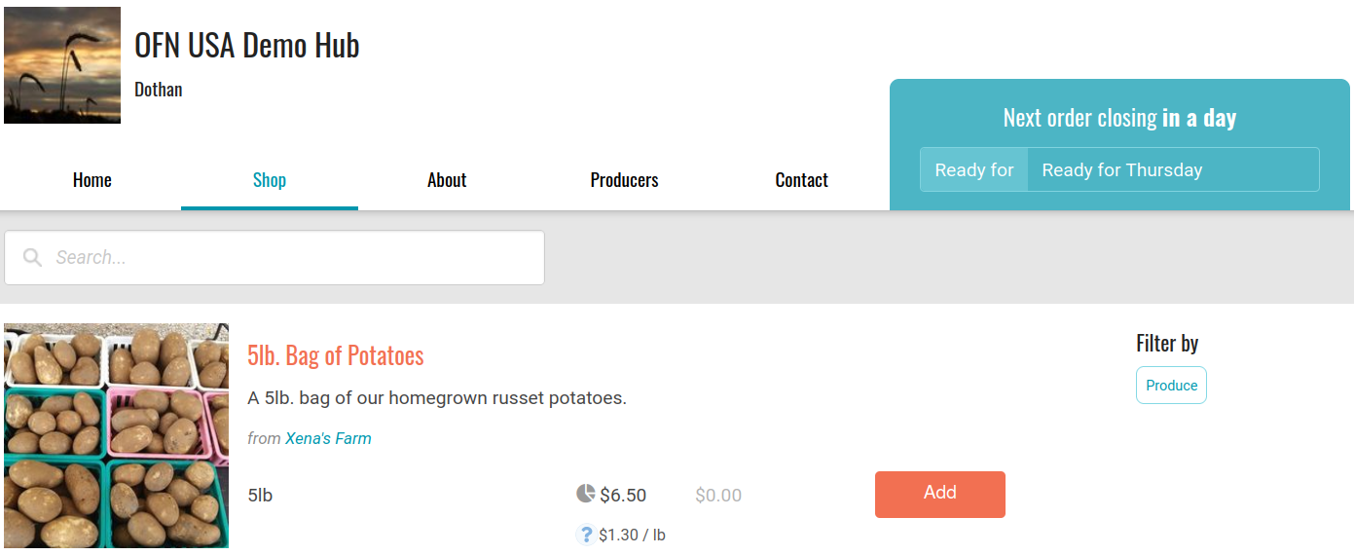
6. Set up an order cycle

Slide 18
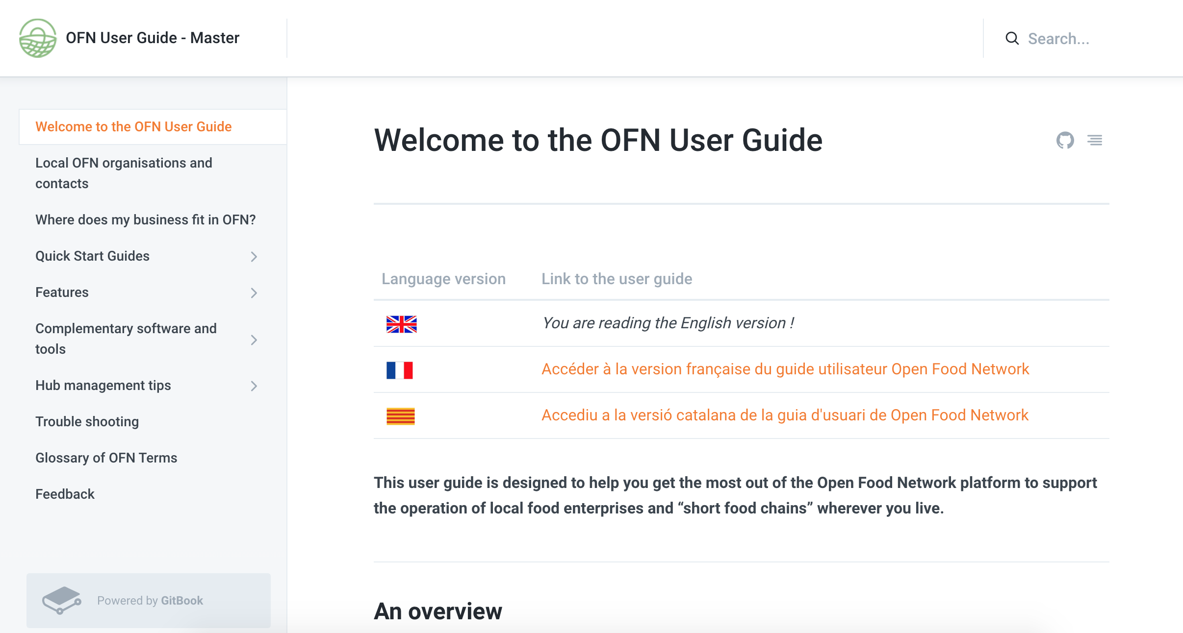
How to get help
https://guide.openfoodnetwork.org/
Email support-usa@openfoodnetwork.net

Slide 19
What the Open Food Network actually does

Slide 20
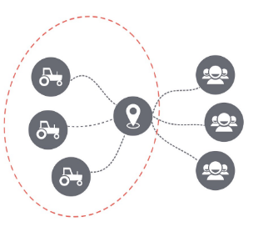
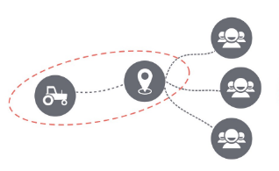
What the Open Food Network is designed to help with
1. Farmer is shop – sells directly and distributes to customers
2. Farmer cooperative or group, manage sales and distribution together

Slide 21
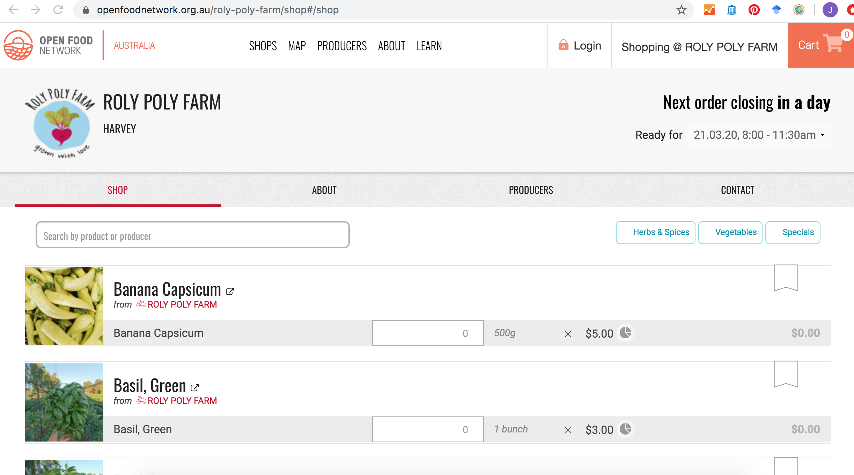
What does the Open Food Network do? Single farm shopfronts

Slide 22
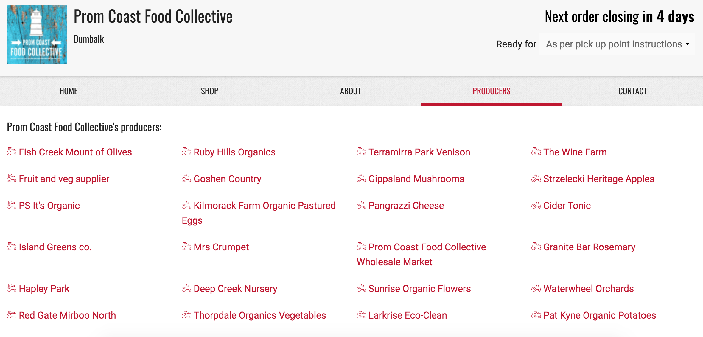
What does the Open Food Network do? Multiple farm/hub shopfronts

Slide 23
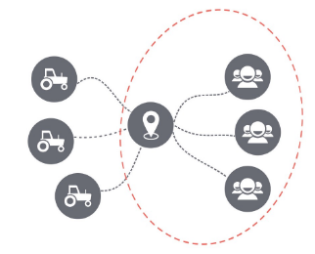
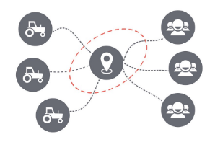
What the Open Food Network is designed to help with
3. Customers collaborate to access from farmers – buying groups and coops
4. Food Hub, multi-farm CSA, Farmers’ Market: 3rd party collaborates with farmers and eaters to organise sale and distribution

Slide 24
What does the Open Food Network do?
Software that makes it easier to manage orders/stock
Reports for delivery and packing
Transparent supply chain
Payment management
Shopping experience that can filter by product type (e.g. fruit) or other food qualities (e.g. organic)

Slide 25
openfoodnetwork.net
YouTube USA
facebook.com/OFNUSA
twitter.com/openfoodnet
instagram.com/ofnusa
YouTube International
guide.openfoodnetwork.org
hello-usa@openfoodnetwork.net

